Slide 1
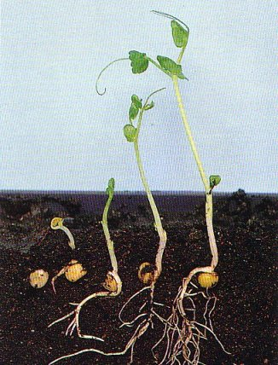
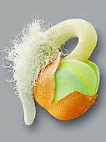
Germination

Slide 2
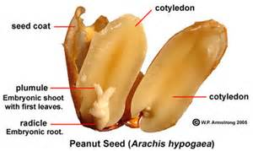
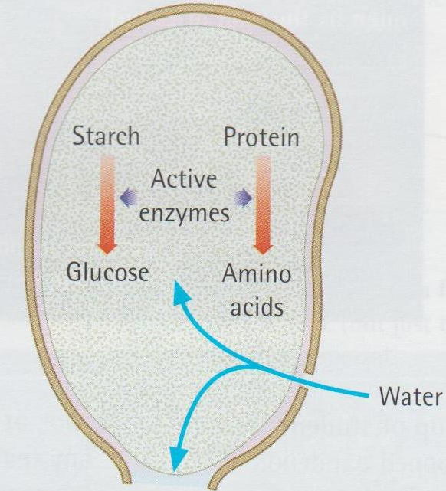
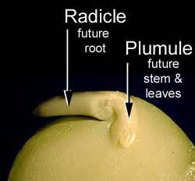
Parts of the embryo
What happens during germination?
Hilum: a scar on the seed coat, marking the place where ovule attached to ovary
Micropyle: a pore on the seed coat. Before fertilization the pollen tube passes through the micropyle. When the seed starts to germinate, water enters the seed through the micropyle.
Radicle: embryonic root
Plumule: embryonic shoot
Notes:
The hilum controls the water content in the final stages of seeds’ formation. It opens in low humidity and closes in high humidity (10% humidity of the seed weight), preventing water absorption. This function of the hilum explains the higher longevity of harder seeds.

Slide 3
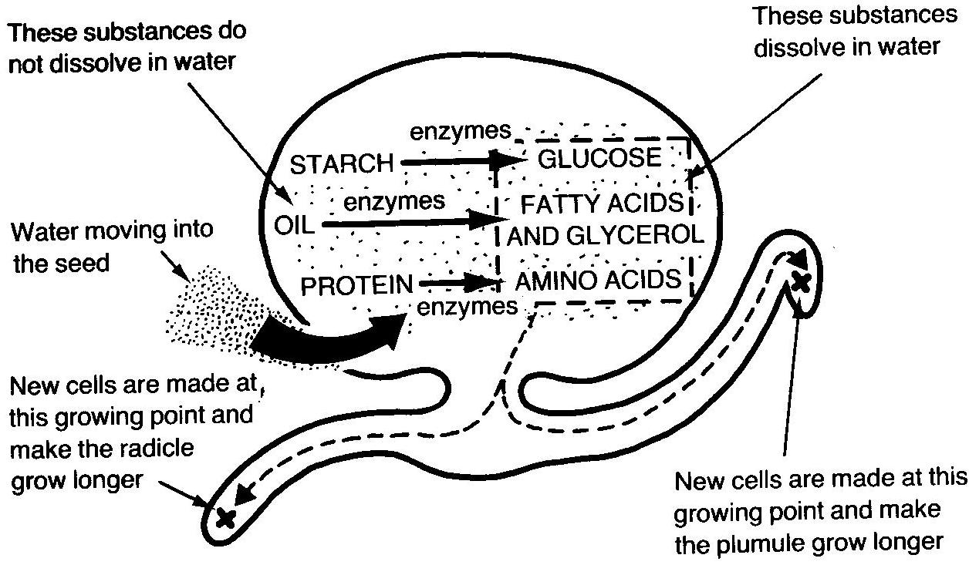
What happened in seeds

Slide 4
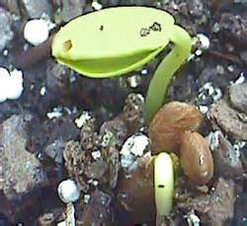
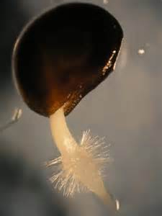
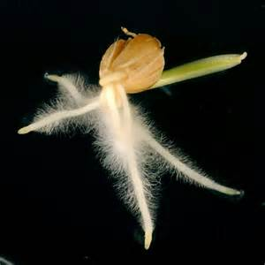
The process of germination

Slide 5
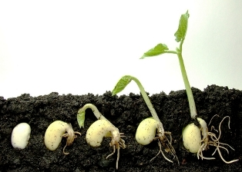
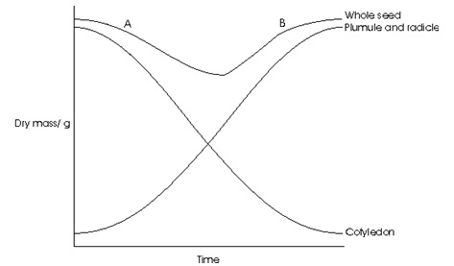
Dry mass changes

Slide 6
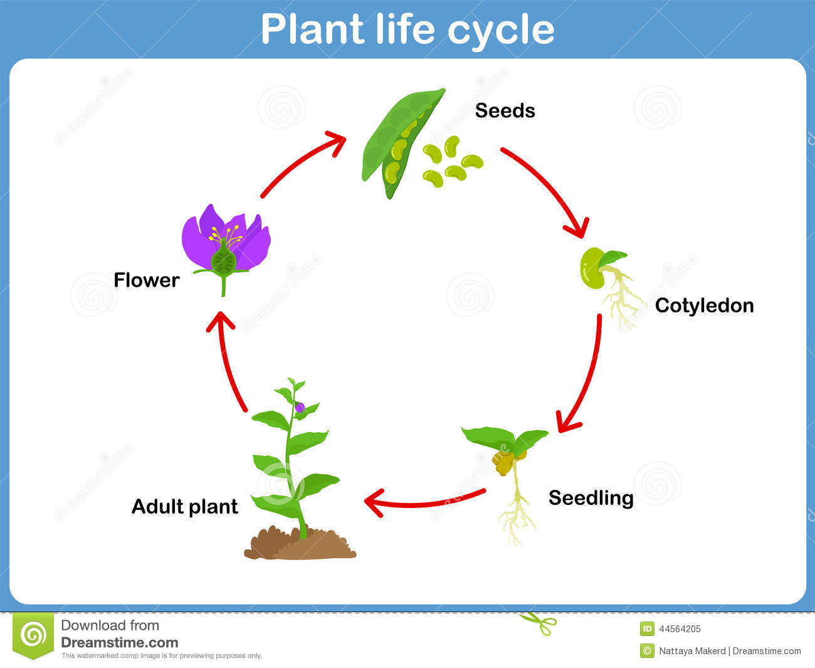
The plant’s life cycle

